Slide 1
03.01
Functions and Methods

Slide 2
Purpose
To describe, at a high level, what the difference between functions and methods are.
How to define a function, and the types that exist.
A look, again, at the idea of lambdas.
Why use one over the other.

Slide 3
What is a Function, what is Method
Functions exist in the global namespace
Methods belong to a class
Process Memory
Class
State
Var-1
Method-A
Method-B
Var-2
Function-A
Var-3
Function-B

Slide 4
Why use functions/classes at all?
Cleaner code
Concept of DRY (Don’t repeat yourself)
Can be separated from other code (e.g. making a library)
Does make things a bit more complicated, but scale considerably better long term.

Slide 5
Proper use of functions
They should rarely, if ever, touch the global namespace.
They should do one thing, and one thing well (Single Responsibility Principal [SRP])
Should be clean, to the point.
It’s okay to chain functions together (e.g. function A, then function B, then function C) – either inside a function or outside the function.
Should exist in the “Helper Methods/Functions” section of your Jupyter notebook.
Can take arguments, but try and limit the number included (<= 3)

Slide 6
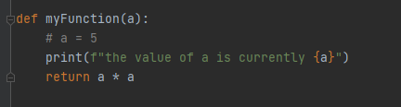
Defining a function
Parameters/Arguments
Starts with “def”
Returns the value to the caller

Slide 7

Using a function
Arguments
Function Name

Slide 8
Lambdas
A “short” version of a function, generally single line, and a “one-off” or a specific use need.
Doesn’t have a return value, the evaluated contents are the return value.
Can accept arguments like any other function
Can be assigned to a variable and called like a function (not recommended)
Most used for filter, map, etc.

Slide 9

Using a lambda
Argument to outer function
Lambda itself
Function using lambda
Lambda body
Incoming
Argument

Slide 10
Concept: Clean Code
Functions/classes/libraries help to segment code by case.
These help reduce duplication (DRY)
Often times these make it easier for end users who depend on your code.
Helps in the aid of: “When I come back to this in 6 months, will I understand what was done?”

Slide 11
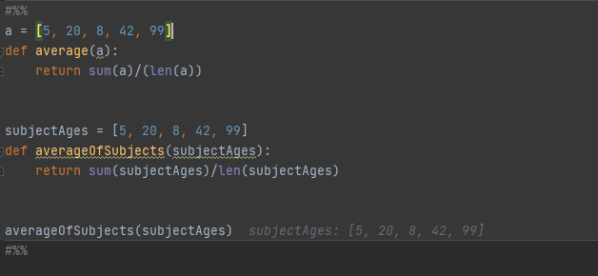
Coming up with “Good names”
Functions, variables, etc. should be well named.
Clearly describe (not too verbose) what it is, and what it holds.

